Slide 1
Competitive learning
In competitive learning, neurons compete among themselves to be activated.
While in Hebbian learning, several output neurons can be activated simultaneously, in competitive learning, only a single output neuron is active at any time.
The output neuron that wins the “competition” is called the winner-takes-all neuron.

Slide 2
The basic idea of competitive learning was introduced in the early 1970s.
In the late 1980s, Teuvo Kohonen introduced a special class of artificial neural networks called self-organising feature maps. These maps are based on competitive learning.

Slide 3
What is a self-organising feature map?
Our brain is dominated by the cerebral cortex, a very complex structure of billions of neurons and hundreds of billions of synapses. The cortex includes areas that are responsible for different human activities (motor, visual, auditory, somatosensory, etc.), and associated with different sensory inputs. We can say that each sensory input is mapped into a corresponding area of the cerebral cortex. The cortex is a self-organising computational map in the human brain.

Slide 4
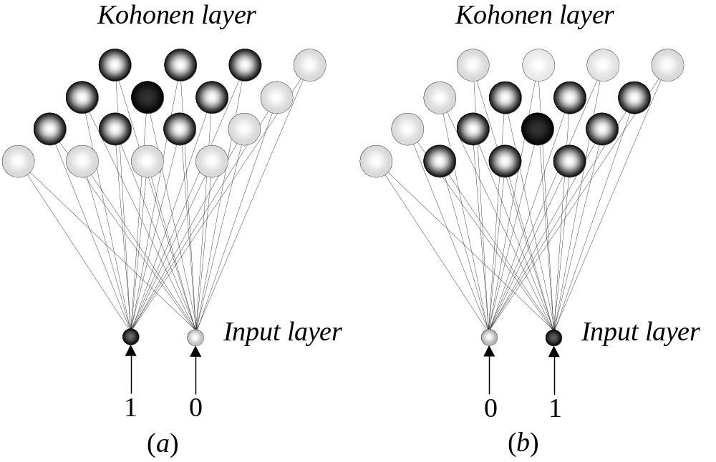
Feature-mapping Kohonen model

Slide 5
The Kohonen network
The Kohonen model provides a topological mapping. It places a fixed number of input patterns from the input layer into a higher-dimensional output or Kohonen layer.
Training in the Kohonen network begins with the winner’s neighbourhood of a fairly large size. Then, as training proceeds, the neighbourhood size gradually decreases.

Slide 6
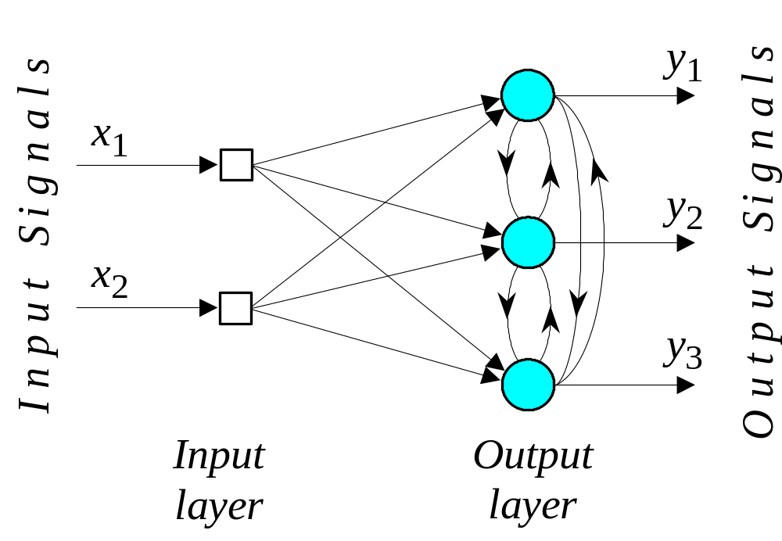
Architecture of the Kohonen Network

Slide 7
The lateral connections are used to create a competition between neurons. The neuron with the largest activation level among all neurons in the output layer becomes the winner. This neuron is the only neuron that produces an output signal. The activity of all other neurons is suppressed in the competition.
The lateral feedback connections produce excitatory or inhibitory effects, depending on the distance from the winning neuron. This is achieved by the use of a Mexican hat function which describes synaptic weights between neurons in the Kohonen layer.

Slide 8
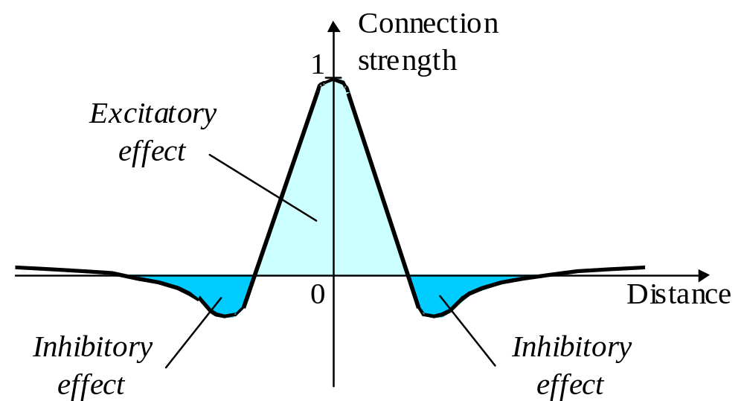
The Mexican hat function of lateral connection

Slide 9
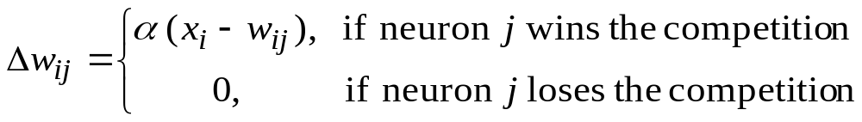
In the Kohonen network, a neuron learns by shifting its weights from inactive connections to active ones. Only the winning neuron and its neighbourhood are allowed to learn. If a neuron does not respond to a given input pattern, then learning cannot occur in that particular neuron.
The competitive learning rule defines the change Δw_{ij} applied to synaptic weight w_{ij} as
where x_{i} is the input signal and α is the learning rate parameter.

Slide 10
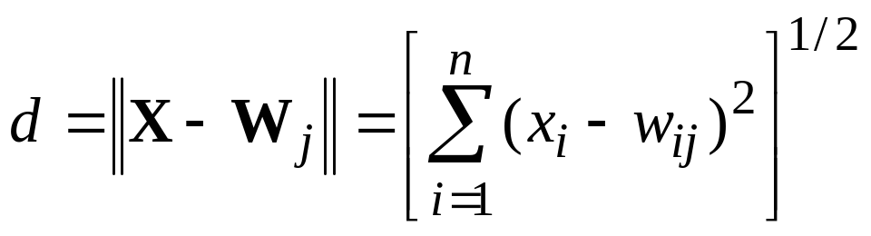
The overall effect of the competitive learning rule resides in moving the synaptic weight vector W_{j} of the winning neuron j towards the input pattern X. The matching criterion is equivalent to the minimum Euclidean distance between vectors.
The Euclidean distance between a pair of n-by-1 vectors X and W_{j} is defined by
where x_{i} and w_{ij} are the ith elements of the vectors X and W_{j}, respectively.

Slide 11
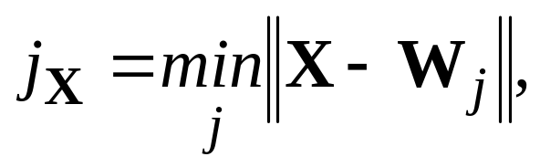

To identify the winning neuron, j_{X}, that best matches the input vector X, we may apply the following condition:
where m is the number of neurons in the Kohonen layer.

Slide 12
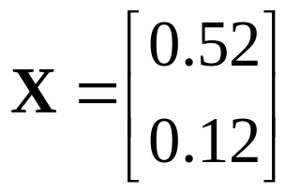
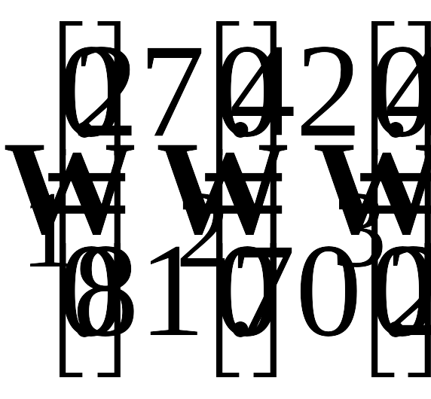
Suppose, for instance, that the 2-dimensional input vector X is presented to the three-neuron Kohonen network,
The initial weight vectors, W_{j}, are given by

Slide 13
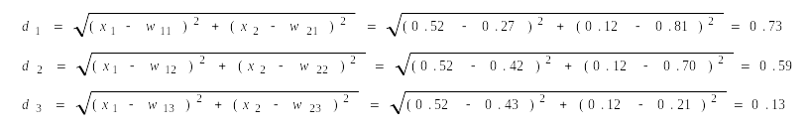

We find the winning (best-matching) neuron j_{X} using the minimum-distance Euclidean criterion:
Neuron 3 is the winner and its weight vector W₃ is updated according to the competitive learning rule.

Slide 14
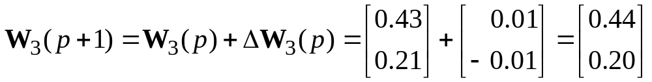
The updated weight vector W₃ at iteration (p + 1) is determined as:
The weight vector W₃ of the wining neuron 3 becomes closer to the input vector X with each iteration.

Slide 15
Competitive Learning Algorithm
Step 1: Initialisation.
Set initial synaptic weights to small random values, say in an interval [0, 1], and assign a small positive value to the learning rate parameter α.

Slide 16
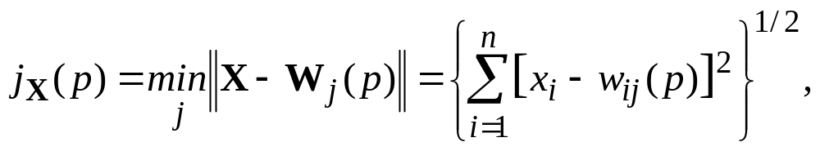
Step 2: Activation and Similarity Matching.
Activate the Kohonen network by applying the input vector X, and find the winner-takes-all (best matching) neuron j_{X} at iteration p, using the minimum-distance Euclidean criterion
where n is the number of neurons in the input layer, and m is the number of neurons in the Kohonen layer.

Slide 17
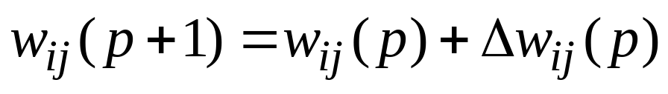
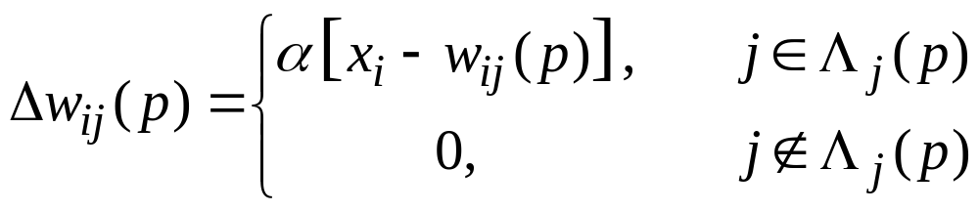
Step 3: Learning.
Update the synaptic weights
where Δw_{ij}(p) is the weight correction at iteration p.
The weight correction is determined by the competitive learning rule:
where α is the learning rate parameter, and Λ_{j}(p) is the neighbourhood function centred around the winner-takes-all neuron j_{X} at iteration p.

Slide 18
Step 4: Iteration.
Increase iteration p by one, go back to Step 2 and continue until the minimum-distance Euclidean criterion is satisfied, or no noticeable changes occur in the feature map.

Slide 19
Competitive learning in the Kohonen network
To illustrate competitive learning, consider the Kohonen network with 100 neurons arranged in the form of a two-dimensional lattice with 10 rows and 10 columns. The network is required to classify two-dimensional input vectors − each neuron in the network should respond only to the input vectors occurring in its region.
The network is trained with 1000 two-dimensional input vectors generated randomly in a square region in the interval between –1 and +1. The learning rate parameter α is equal to 0.1.

Slide 20
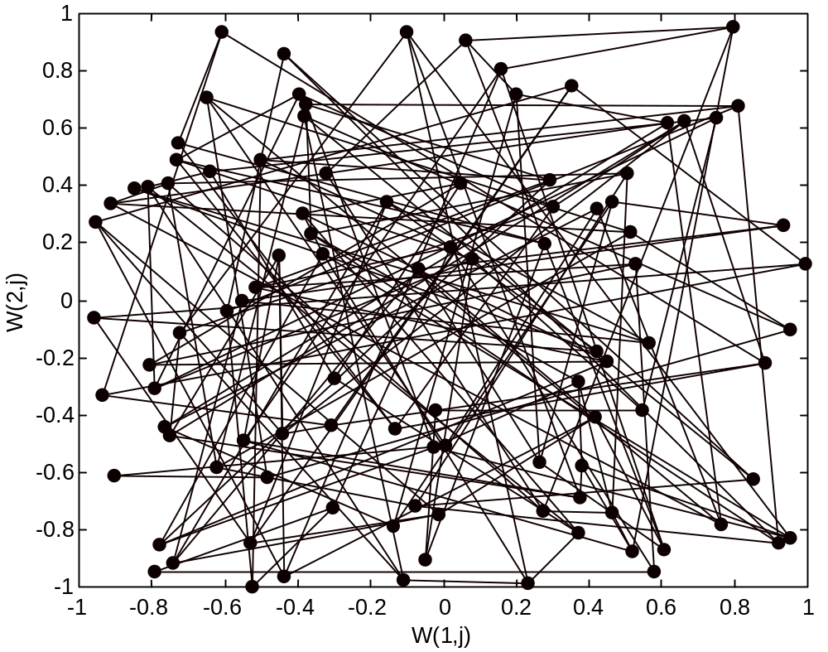
Initial random weights

Slide 21
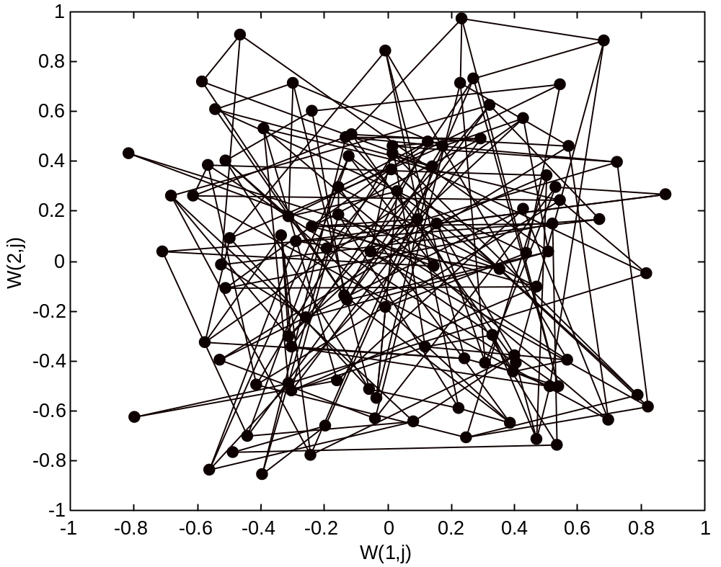
Network after 100 iterations

Slide 22
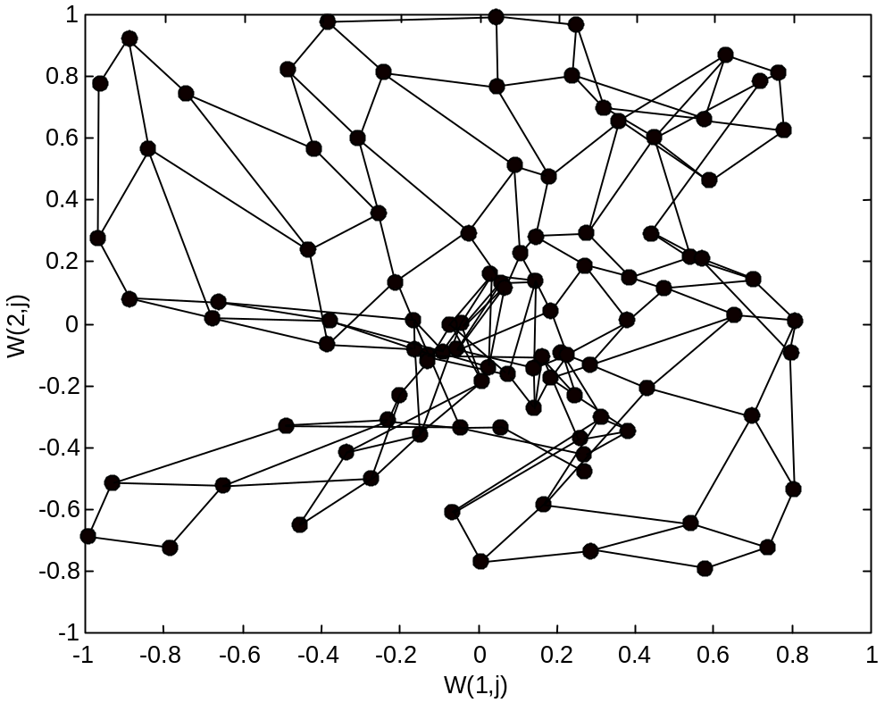
Network after 1000 iterations

Slide 23
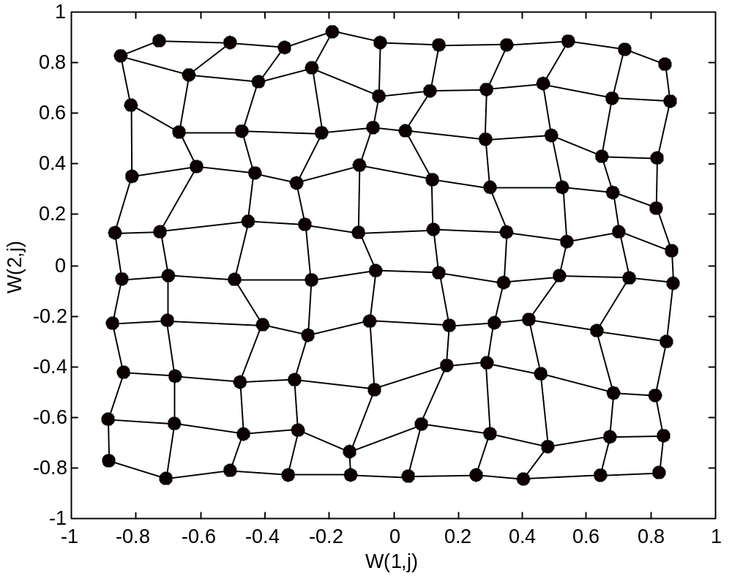
Network after 10,000 iterations

Slide 24
